Slide 1
CORE API

Slide 2
Event Emitter
Fundamental pattern and core module( implemented as part of Node.JS)
API that allows asynchronous programming.
Follows Observer Pattern.
Extended and used by many node core api (http server object, streams, process objects).
Complement to callback pattern.

Slide 3
Event Emitter
Listener
Event
Listener
Event Emitter
Event
Listener

Slide 4
Event Emitter is nothing but prototype
Extend and use it in your code
var EventEmitter = require(‘events’).EventEmitter;
var myEE = new EventEmitter();
myEE.on(event, listener); // registering the event
myEE.once(event, listener); // registering for only one occurrence of event
myEE.emit(event, [arg1.. argN] //Emit the event and run the listener
myEE.removeListener(event,listener);//remove the listener

Slide 5
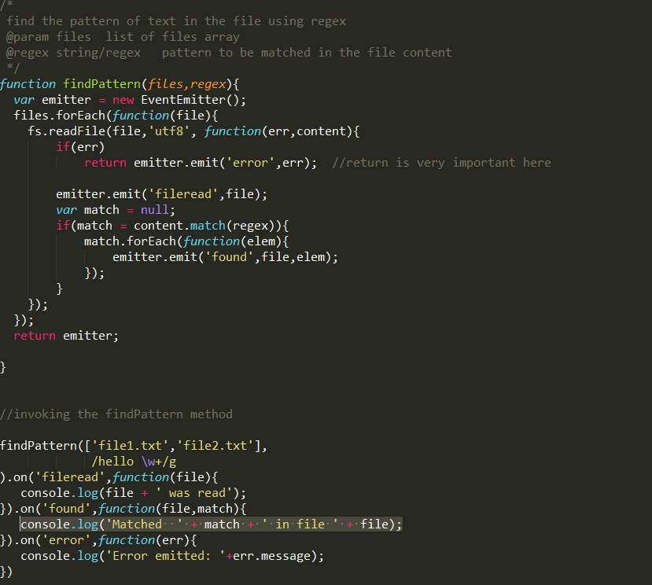
Naive Event Emitter

Slide 6
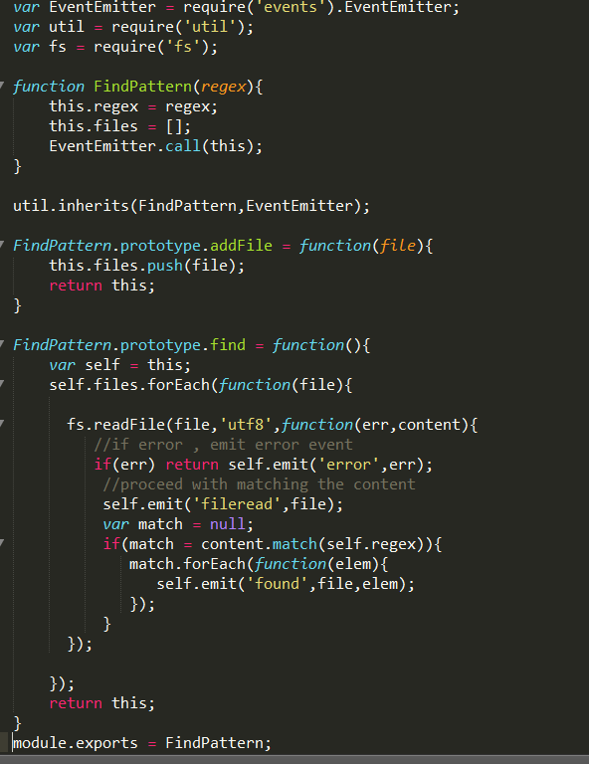
Modular Event Emitter
Most common way of extending EventEmitter
to make Observable Class

Slide 7
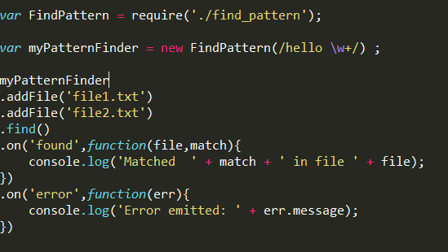

Slide 8
Event Emitter
Try to avoid writing synchronous code in event emitter.
function SyncEmit(){
this.emit(‘ready’);
}
utils.inherits(SyncEmit,EventEmitter);
//invoking
var mySyncEmit = new SyncEmit()
mySyncEmit.on(‘ready’ , function() {
console.log(‘ready event fired’);
});

Slide 9
Event Emitter vs Callback
Both are complement to one another.
Both can be used to achieve asynchronous code flow.
Callback – used when results should be returned in async way.
EventEmitter – used to communicate some event has happened.

Slide 10
STREAMS

Slide 11
STREAMS
Streams are core Node.JS module to achieve high scalability for I/O operations.
Streams are eventEmitters.
All core Node.JS objects are streams like http server object, socket, process object, fs methods

Slide 12
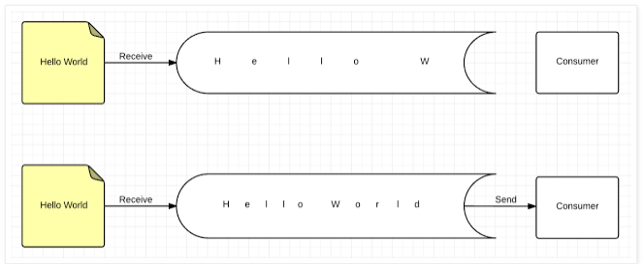
Buffering
Buffering is slow and constraint to memory limits.
No controlling mechanism .
Very Inefficient for large I/O ( in terms of performance)
Reading file using fs.readFile is done using buffering method.

Slide 13
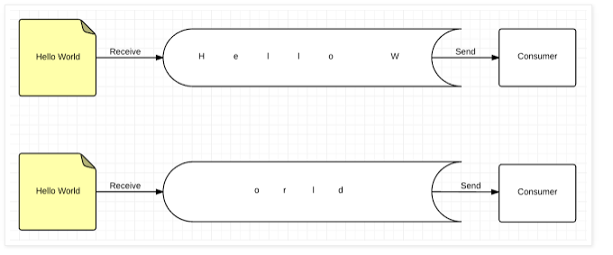
Streaming
Highly efficient I/O in terms of performance
Like Unix Pipe mechanism.
Composablity.
Can be controlled.(can be paused /resumed).

Slide 14
Streams - Types
stream.Readable
stream.Writable
stream.Duplex
stream.Transform

Slide 15
Modes of Streams
Object Mode
Streaming data can be any discrete javascript value (except null).
Binary Mode
Data is streamed in the form of chunks. (socket , file data, binary data)

Slide 16
Readable Stream.
Two types of readable modes
Flowing mode.
Paused mode.

Slide 17
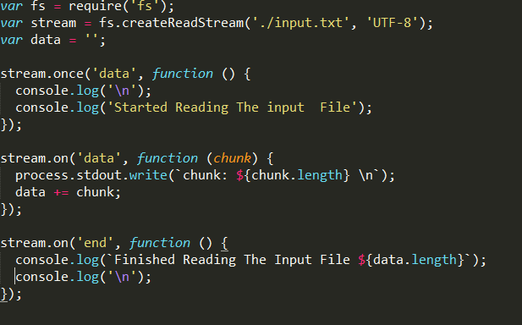
Flowing Mode
Data flows between src and destincation
like unix pipe cat file.txt | wc –l
Has events associated to indicate progress like ( ‘data’, ‘end’, ‘close’ ,’error’);

Slide 18
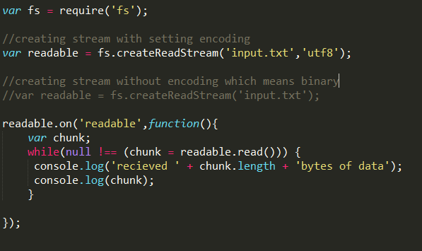
Paused mode
We need to explicitly read using read api stream.read(size).

Slide 19
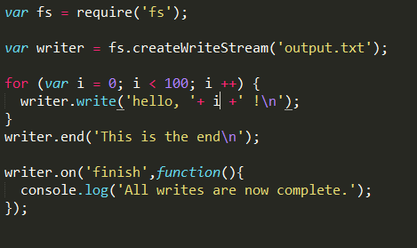
Writable Stream

Slide 20
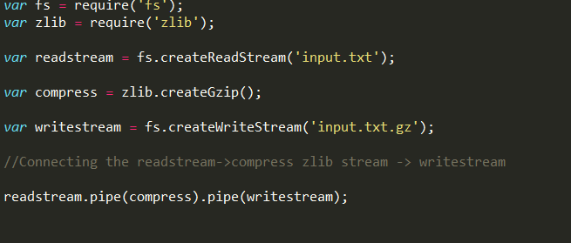
Piping streams
Cat input.txt | tar –zvx –

Slide 21
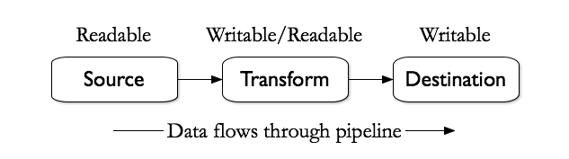
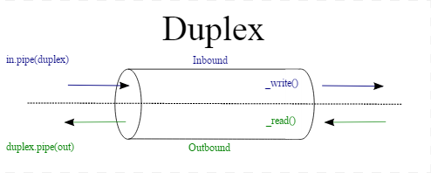
Transform / Duplex stream
“through” is one of famous transform library.

Slide 22
Exercise
Try to make http call and read the content of http request using streaming approach
Try to use http core module . Use http.get method.

Slide 23
Global Objects
Available throughout the applications
process
console
require
__filename
__dirname
module.exports
setTimeout(cb,ms)
clearTimeout(t)
setInterval(cb,ms)
clearInterval(t)

Slide 24
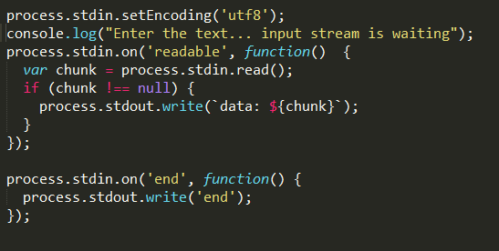
Process
To access the current Node.js process information
Very useful when writing the command line application
Has events associated with it
process.env // environment
process.stdin //input readable stream
process.stdout //output writable , alias to console.log

Slide 25
API Overview – Core Modules
https://nodejs.org/dist/latest-v6.x/docs/api/
buffer – Handling binary data (octet streams like TCP)
events – Generic Observer Module - EventEmitter

Slide 26
Core Modules
Assertion testing
Buffer*
C/C++ Addons
Child process
Cluster
Crypto
DNS
Events*
File System*
Path*
Process*

Slide 27
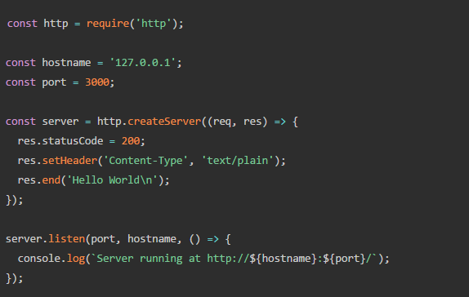
Core Modules
HTTP/HTTPS*
Net
OS
Stream*
QueryStrings*
REPL
Timers*
TLS/SSL
URL*
UDP
Utilities
ZLIB*

Slide 28
Timers
Cannot guarantee the exact time when callback will get execute
No ordering of time is maintained
Scheduling Timers
setImmediate(cb, [..args]);*
setInterval(callback, delay[, ...args])
setTimeout(callback, delay[, ...args])
Cancelling Timers
clearImmediate(immediate)
clearInterval(timeout)
clearTimeout(timeout)
Process.nextTick(cb);*

